Slide 1
Credit Card Fraud Detection: A Hybrid Approach
DATA ANALYTICS AND PROGRAMMING
NCI
X21235571
By: Damilare Kolawole
Supervisor: Vikas Tomer

Slide 2
Agenda
Introduction
Literature Review
Methodology
Implementation
Results and Performance

Slide 3
INTRODUCTION
Credit card fraud has surged in recent years, impacting both individuals and financial institutions significantly. The increase in digital transactions, along with technological advancements, has made credit card fraud a pervasive issue.
RQ1: How can a Hybrid Deep Learning Approach be effectively trained to address imbalanced
datasets in credit card transactions, where legitimate transactions outnumber fraudulent ones,
to improve Credit Card Fraud Identification and Detection, thereby benefiting financial
institutions, businesses, and cardholders?
RQ2: What is the evaluation of the proposed Hybrid deep learning approach, compared to the
existing ones in credit card fraud detection hence improving detection systems for financial
institutions, merchants, businesses, and cardholders?

Slide 4
Literature review
Author | Model | Transaction Data | Metrics Used | Results | Limitation
(Fanai and Abbasimehr, 2023) | Deep Autoencoders | European Cardholder dataset, German Credit Dataset | AUC-PR Precision F1 score AUC-ROC | 56% 68% 62% 72% | Class imbalance was not addressed in this study which could lead to model instability
(Ullastres, 2022b) | Ensembling Learning | Simulated Credit Card Transactions generated using Sparkov | AUC-PR MCC F1 score | 73% 71% 70% | The author focuses on tree-based ensemble classifiers and did not address the issue of Class imbalance.
(Zhang et al., 2021) | Homogeneity-oriented behavior analysis (HOBA) | Real-life dataset | Accuracy F1 score Precision | 75% 47% 35.24% 71.68% | Class Imbalance in a real-life dataset should have been addressed properly
(Chalwadi, 2021) | Neural Network MLP | European credit card transaction data | Accuracy Precision Recall F1-Score | 99.75% 95.91% 50.81% 66.43% | The researcher did not address how class imbalance influences the training of the Neural Network MLP classifier and whether this affects the model capacity to effectively identify fraudulent transactions.
(Misra et al., 2020) | Autoencoders | European Dataset | Accuracy Precision Recall F1-Score | 99% 85% 80% 82% | The author did not address class imbalance
(Fiore et al., 2019) | GAN | Simulated Data | Accuracy F1 score Precision | 99% 81% 94% | Class imbalance was not addressed properly
(Zhang and Trubey, 2019) | SVM and RF | US transaction data | Adjusted R^2 | 49% | the researcher does not go into detail on how they dealt with data quality problems or preprocessing stages, which have a substantial impact on model outputs.

Slide 5
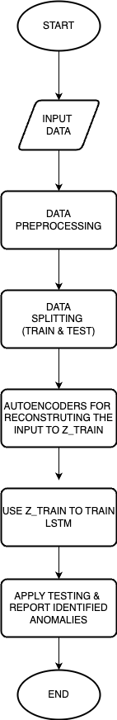
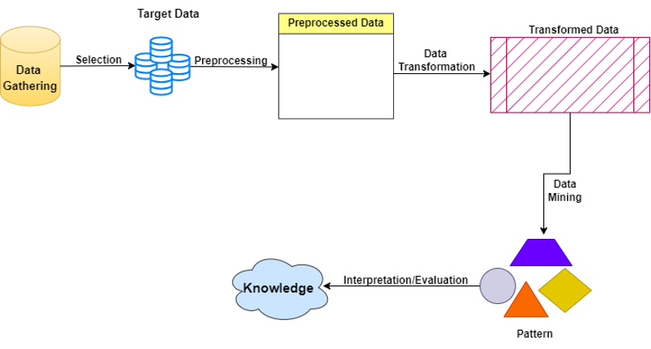
Methodology

Slide 6
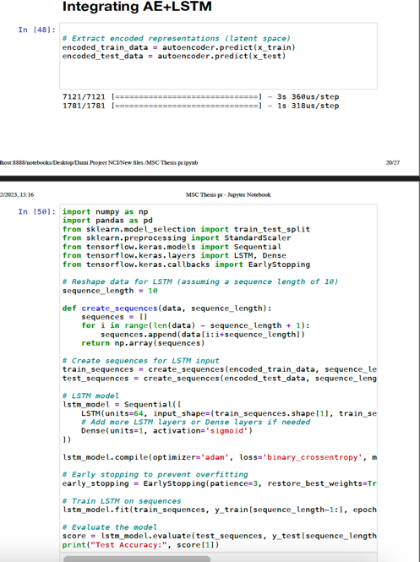
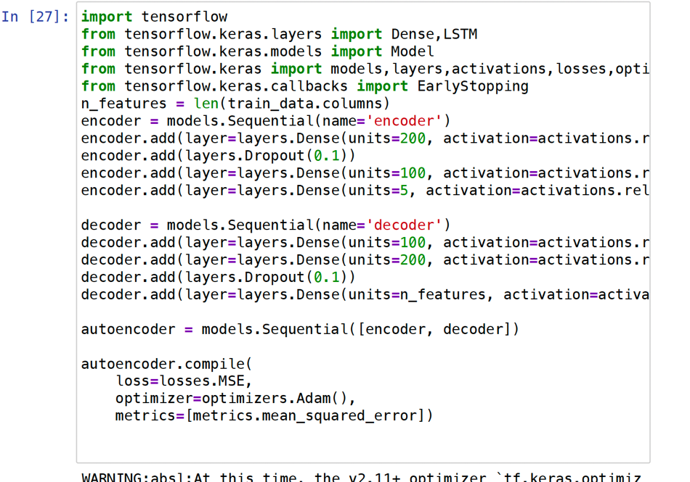
Implementation

Slide 7
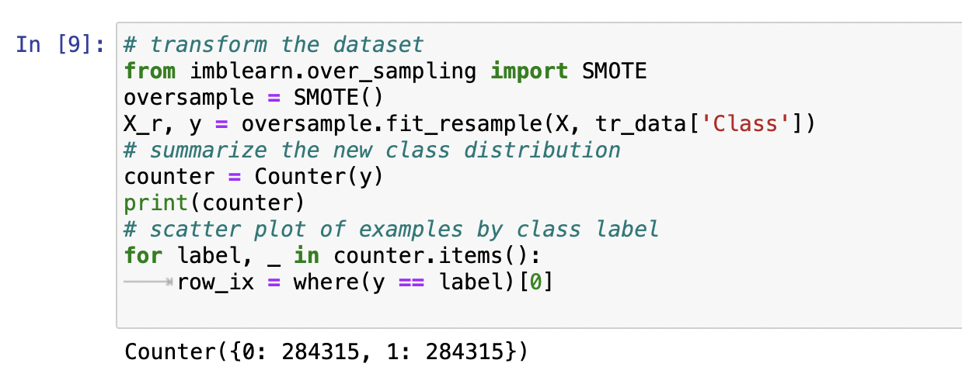
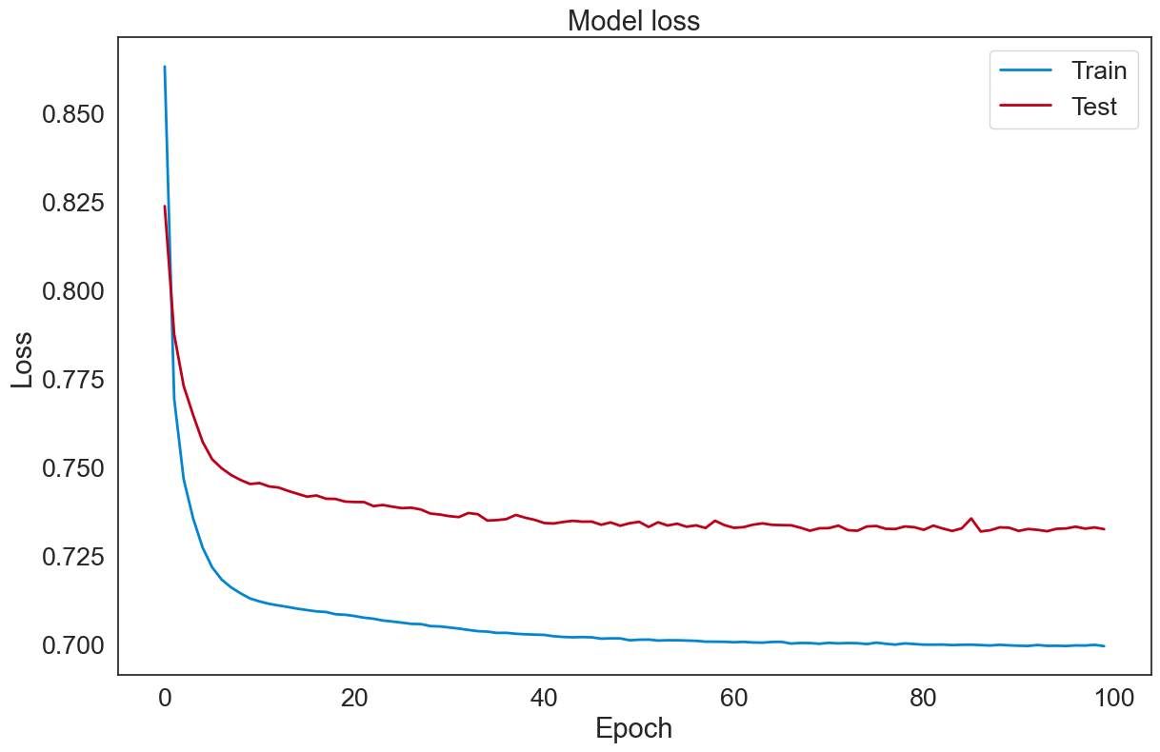
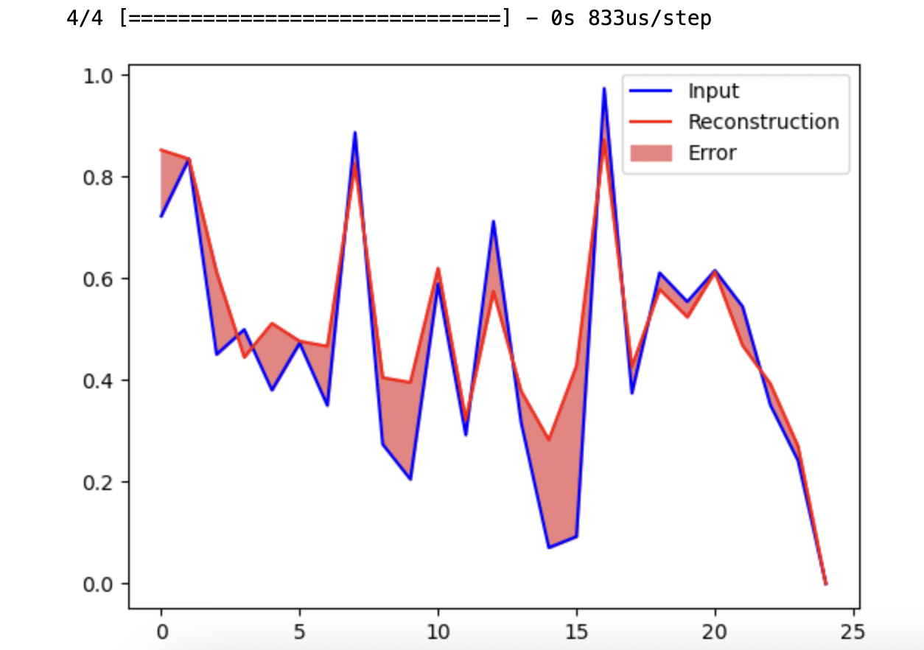
Implementation (cont’d)

Slide 8
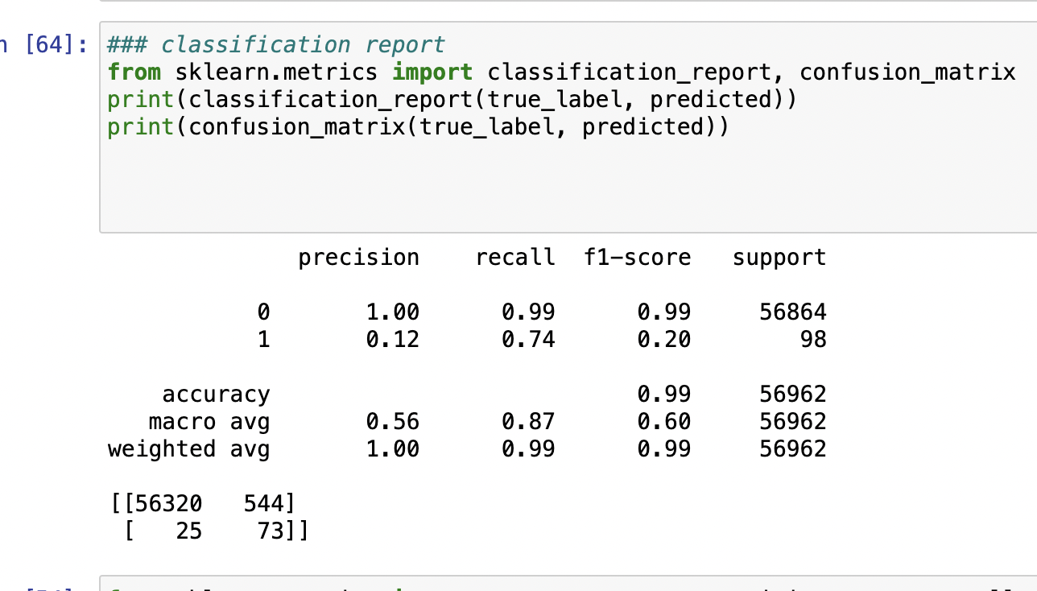
Classification Report

Slide 9
Results and Evaluation
Autoencoders
Precision | Accuracy | F1-score | Recall
0.106 | 0.987 | 0.100 | 0.106
LSTM
Precision | Accuracy | F1-score | Recall
0.986 | 0.937 | 0.934 | 0.887
Compare with existing algorithms
AE+LSTM | Precision | Accuracy | F1-score | Recall
 | 1.00 | 0.998 | 0.991 | 0.990
(Fiore et al., 2019) GAN | 0.94 | 0.99 | 0.81 | -
(Chalwadi, 2021) Autoencoders | 0. 959 | 0.997 | 0.664 | 0.558

Slide 10
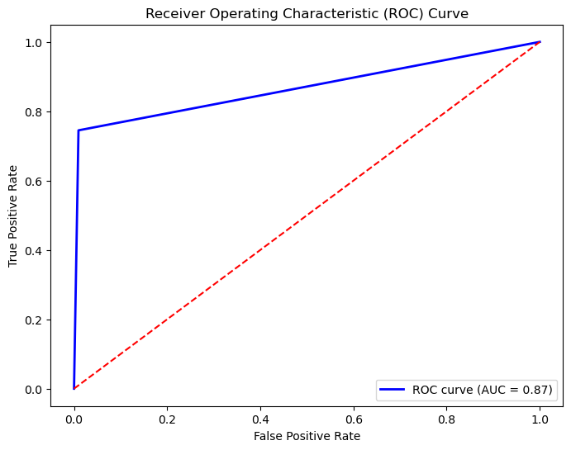
Results and Evaluation Cont’d

Slide 11
Conclusion and Recommendation
the Hybrid Deep Learning Model offers improved fraud detection capabilities. Recommendations include further research in refining the model and its implementation in real-world scenarios. Attention Mechanism could also be integrated for better performance of the model and a better ROC curve.

Slide 12
THE END
THANK YOU

